Slide 1
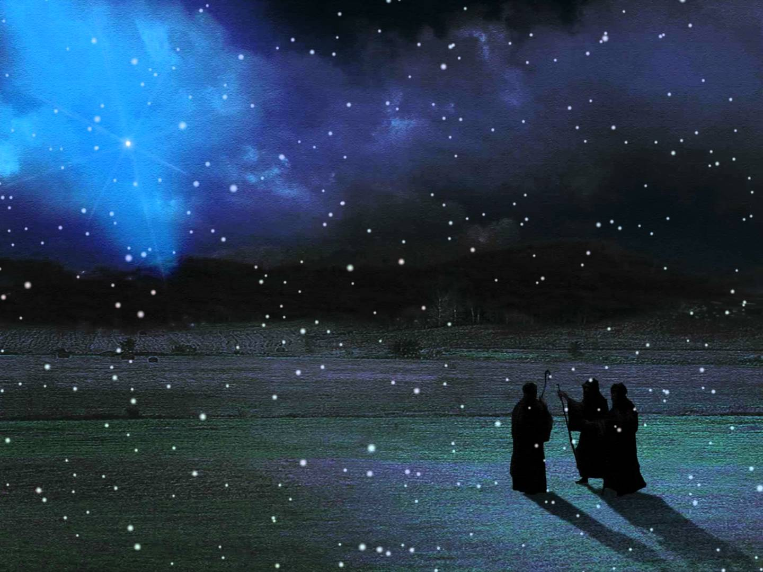

Slide 2
在一個馬槽裡
Away in a Manger

Slide 3
1.在一個馬槽裡，
Ti chit e be- cho lai,
無搖籃可用，
Bo io- na thang eng,
1. Away in a manger,
No crib for a bed

Slide 4
這小漢主耶穌，
Che soe- han Chu Ia- so,
整夜睡靜靜，
Kui mi khun cheng-cheng,
The little Lord Jesus
Laid down His sweet head;

Slide 5
在天上有星辰，
Ti thi^{n}- teng u chhi^{n}-sin,
在照祂面貌，
The chio I bin- mau,
The stars in the bright sky
Looked down where He lay

Slide 6
這小漢主耶穌
Che soe-han Chu Ia-so,
在睡在乾草。
Teh khun ti ta-chhau.
The little Lord Jesus,
A-sleep on the hay.

Slide 7
2.牛羊出大聲了，
Gu-iu^{n} chhut toa sia^{n} la,
嬰仔都無驚，
E^{n}- a long bo kia^{n},
2. The cattle are lowing,
the Baby awakes,

Slide 8
這小漢主耶穌，
Che soe- han Chu Ia- so,
都無哭一聲，
Long bo hau chit sia^{n},
But little Lord Jesus,
No crying He makes;

Slide 9
主耶穌我愛祢，
Chu Ia- so goa thia^{n} Li,
懇求祢通暝，
Khun- kiu Li thong-mi,
I love Thee, Lord Jesus!
Look down from the sky,

Slide 10
來住在我身邊
Lai tiam- ti goa sin- pi^{n},
到天光的時。
Kau thi^{n}- kng e si.
And stay by my cradle
Till morning is nigh.

Slide 11
3.主耶穌我求祢，
Chu Ia- so goa kiu Li,
常常與我住，
Siong-siong kap goa toa,
3. Be near me, Lord Jesus!
I ask Thee to stay,

Slide 12
各日求祢照顧，
Tak jit kiu Li chiau-ko,
永遠來愛我，
Eng-oan lai thia^{n} goa,
Close by me forever
and love me, I pray;

Slide 13
願世界眾小子，
Goan se-kai cheng soe-kia^{n},
都受祢祝福，
Long siu Li chiok-hok,
Bless all the dear children
In Thy tender care

Slide 14
路尾到於天上
Lo- be kau ti thi^{n}-teng,
永遠的快樂。
Eng- oan e khoai-lok.
And fit us for heaven,
To live with Thee there.

